Slide 1
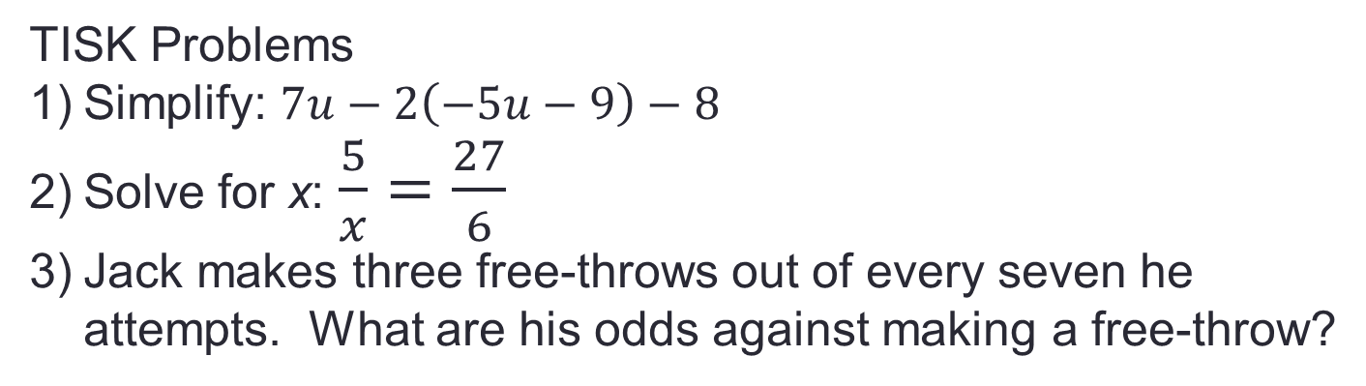
Wednesday, Nov. 14, 2012
Agenda:
TISK & MM
HW Check
Lesson 10-4 pt 1: Solve & Graph Inequalities
Homework: p. 517-518 #27-37 odd & 40 (due on Fri!)
TISK Problems
Simplify: $7u−2\left(−5u−9\right)−8$
Solve for x: $\frac{5}{x}=\frac{27}{6}$
Jack makes three free-throws out of every seven he attempts. What are his odds against making a free-throw?
We will have 2 Mental Math questions.
Notes:
Mental Math
1.) Start with 48. Divide by -8. Double it. Add 48. Take the square root. Subtract 9. (-3)
2.) Start with 54. Divide by -6. Double it. Add 67. Take the square root. Subtract 10. (-3)

Slide 2

Homework Check
510 #22-32
22) $n=3$
23) $n=2$
24) $x=∅$
25) $x=5$
26) $p=3$
27) $m=3.5$
28) $x=2$
29) $x=7$
30) $r=10$
31) 360 units
32) 28 units

Slide 3
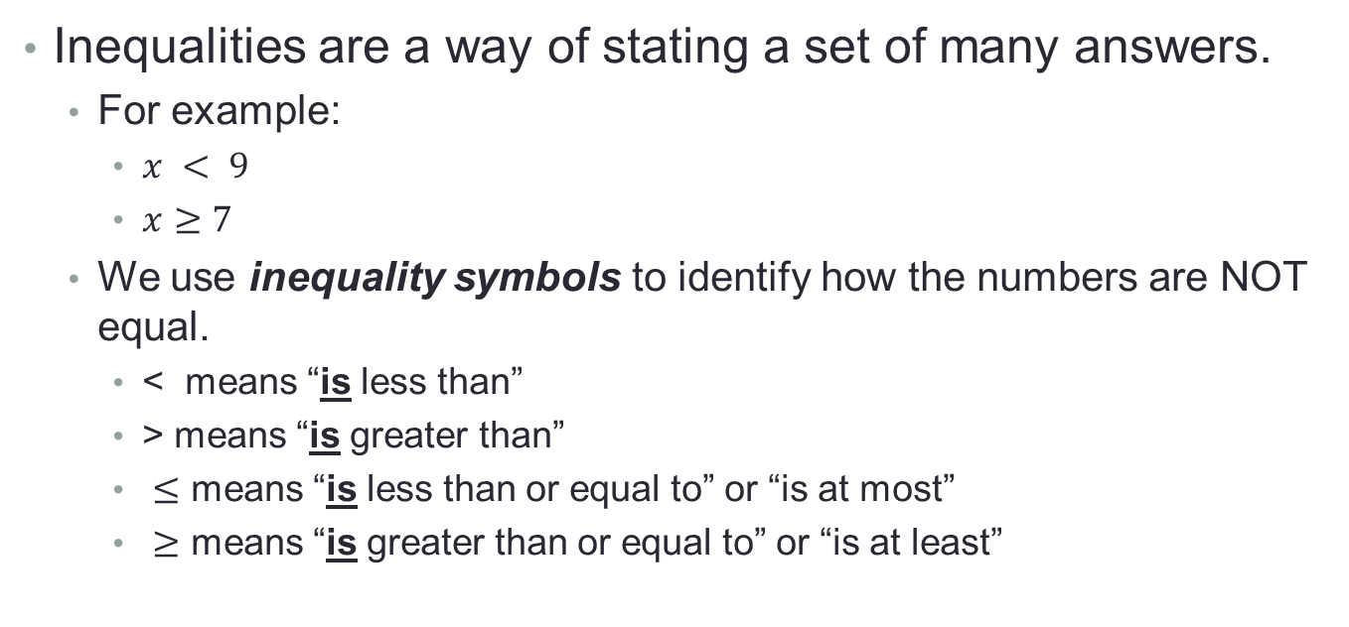
§10-4 Solving Multi-Step Inequalities
Inequalities are a way of stating a set of many answers.
  For example:
    $x < 9$
    $x≥7$
  We use inequality symbols to identify how the numbers are NOT equal.
    < means “is less than”
    > means “is greater than”
    $≤$ means “is less than or equal to” or “is at most”
    $≥$ means “is greater than or equal to” or “is at least”

Slide 4
§10-4 Solving Multi-Step Inequalities
Graphing Inequalities
  To show a solution to an inequality, you graph it using a number line to show all the possible numbers that could be solutions to the inequality.
  For example: x < 9
-4
-3
-2
-1
0
1
2
3
4
5
6
7
8
9
10
12
14
16
17
11
13
15
Which numbers are solutions to the inequality?
(Which numbers are less than 9?)
It is impossible to plot every solution individually, so we simply shade the line to indicate the solutions…

Slide 5
Important things to notice…
-4
-3
-2
-1
0
1
2
3
4
5
6
7
8
9
10
12
14
16
17
11
13
15
The arrow is shaded because the solutions continue past the point I’ve drawn the number line.
This circle is NOT filled in, because x < 9 but not equal to it.
Circles with no filling are called “open circles”.
If the problem was:
then the solution would be…
-4
-3
-2
-1
0
1
2
3
4
5
6
7
8
9
10
12
14
16
17
11
13
15
Circles with filling are called “closed circles”.

Slide 6
You Try it
Graph the inequality.
x < 3
x > 10
x 5

Slide 7
Solving Inequalities…
When you solve inequalities, make sure your final answer has the variable on the left.
Be careful when MULTIPLYING or DIVIDING by negative numbers..!
  If you multiply or divide by a negative number, you have to flip the inequality sign.

Slide 8
Solve the inequality; graph the solution.
5
6
7
8
2
3
4
5
-5
-4
-3
-2
-5
-4
-3
-2
Check Point.

Slide 9
Example. Solve the inequality.

Slide 10
Checkpoints. Solve the inequality.

Slide 11
Solve the inequality.

Slide 12
Solve the inequality.

Slide 13
Solve the inequality.

Slide 14
Solve the inequality.

Slide 15
Solve the inequality.

